Slide 1
Welcome to the Monthly KESA Updates and Support Meeting!
This session is scheduled to start promptly at 9:00 a.m.
Notes:
This session is scheduled to start promptly at 9:00 a.m. providing!

Slide 2
Kansas Education System Accreditation (KESA) Update
February 8, 2022
Notes:
Welcome everyone to the KESA Update for February. I am glad to see and be able to visit with you today. (next slide)

Slide 3
Today’s Purpose
ARC Reviews – Things to know!
General Updates
New Team at KSDE
Accreditation Definitions
Answer any of your questions

Slide 4
ARC Reviews – Things to know!

Slide 5
ARC Review of Year Five: Things to know
Be sure to use the correct form – OVT, and System
Ensure that the goals are clear
Not an area only
SMART goals to the extent possible.
As evidenced by…
To the extent possible be sure to provide information about growth/change in your response.
Be very clear about artifacts.
Not much time for the ARC
Notes:
The most important thing is to be sure that a goal is listed that provides a clear indication of where the system was headed, the data points that identified the need and would consequently provide information on growth,

Slide 6
General Updates

Slide 7
General Updates
KESA Application
Currently Reviewing the OVT Forms for production
If having a visit this month (all years), please be sure that your OVT Chair uses the forms on the website.
Artifacts found in System Response section
Any problem please send to accreditation@ksde.org to be sure they are addressed in a timely manner.
Save often
Accreditation Advisory Meeting Update
Accreditation Review council Update
Notes:
Last month mentioned we were putting out a request for nominations for ARC

Slide 8
General Updates and Reminders
OVT Online Training - https://learning.ksde.org/course/index.php?categoryid=40
Guidance Document - https://www.ksde.org/Portals/0/TLA/Accreditation/KESA%20Resources/Kansas%20Education%20Systems%20Accreditation%20Guidance%202021-2022.pdf?ver=2022-01-21-142733-230
Notes:
Guidance Document
Currently under final review and scheduled online by next week.

Slide 9
General Updates and Reminders
OVT Chair Training – Two additional dates:
Monday, February 14th Meeting 9:00-11:00
Register in advance for this meeting:
https://ksde.zoom.us/meeting/register/tZIqdOyrqD8qGNDZw6vL6Q1tuG5gMO6NdTI3
Wednesday, February 16th Meeting 1:00-3:00
Register in advance for this meeting:
https://ksde.zoom.us/meeting/register/tZUvc-urqj0vHtaDCWB1MZjB252A1TRYwQbv
Notes:
After registering, you will receive a confirmation email containing information about joining the meeting.

Slide 10
New Team, New Times

Slide 11
What?
The KESA and Redesign teams are joining forces to support systems and schools.
The name of the team has not yet been determined or finalized.
The team will oversee accreditation and school/system design.
Notes:
Jay

Slide 12
Who?
Team members in alphabetical order….
Jay Scott
Jeannette Nobo
John Girodat
Myron Melton
Pat Bone providing AA support for now
Sarah Perryman
Tammy Mitchell
1 unfilled position
Notes:
Tammy

Slide 13
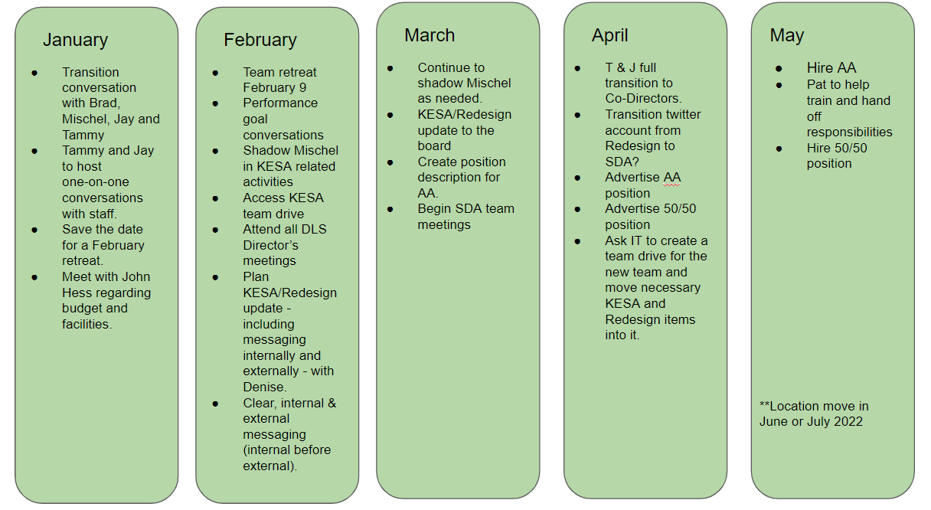
When? Now!
Spring 2022 Transition Plan
Notes:
Jay

Slide 14
What’s Next?
Team retreat next Wednesday, February 9
Decide on a team name
Continue regional training pilot
Continue to support systems who are coming before the ARC this spring
Goal setting and action planning for future work
Notes:
Tammy

Slide 15
You may have questions. We may or may not have answers.
Feel free to ask us!
Notes:
Jay

Slide 16
Accreditation Definitions

Slide 17
Accreditation Definitions
“Accredited” means the system is in good standing (compliance) with the State Board, and that they have provided conclusive evidence of growth in student performance. In addition, the system has provided conclusive evidence of an intentional, quality growth process.

Slide 18
Accreditation Definitions
“Conditionally Accredited” means the system is in good standing (compliance) with the State Board, and either the system did not provide conclusive evidence of growth in student performance or was not able to provide conclusive evidence of an intentional, quality growth process.

Slide 19
Accreditation Definitions
“Not Accredited” means one of two things:
The system is not in good standing (compliance) with the State Board; or
The system did not provide conclusive evidence of growth in student performance, and the system was not able to provide conclusive evidence of an intentional, quality growth process.

Slide 20
2021-2022 Monthly KESA Updates
Tuesday, October 12, 2021
Tuesday, November 9, 2021
Tuesday, December 14, 2021
Tuesday, January 11, 2022
Tuesday, February 8, 2022
Tuesday, March 8, 2022
Tuesday, April 12, 2022
All KESA monthly updates are done via Zoom and recorded. They are scheduled from 9:00 – 10:00 a.m. on the dates listed above.
Registration: https://ksde.zoom.us/meeting/register/tZMpfu6prDgqG9NdArF0ovR2otXJyBq0U_Oe
Notes:
Please mark your calendars for next year’s KESA Updates. A reminder with the dates, time and zoom link for registration will be sent out in August.

Slide 21
Questions?

Slide 22
Thank You!

Slide 23
Dr. Mischel D. Miller Director Teacher Licensure and Accreditation (785) 296-8010 mmiller@ksde.org
Jeannette Nobo
Assistant Director- KESA Teacher Licensure and Accreditation (785) 296-4948 jnobo@ksde.org
Myron Melton
KESA Coordinator
Teacher Licensure and Accreditation
(785) 296-8110
mmelton@ksde.org
John Girodat
Education Program Consultant - KESA
Teacher Licensure and Accreditation
(785) 368-7356
jgirodat@ksde.org
Ed Kalas, Education Program consultant
Professional Learning and Mentoring
Teacher Licensure and Accreditation
(785) 296-2198
ekalas@ksde.org

